Slide 1



Slide 2

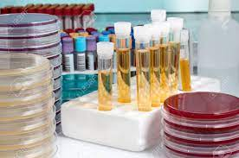
Single Use Medical Devices
Gunturu Revathi
Head of Clinical Microbiology
The Aga Khan University Hospital, Nairobi
IPNET Conference 2025
15th -17th Sept 2025
PrideInn Mombasa

Slide 3

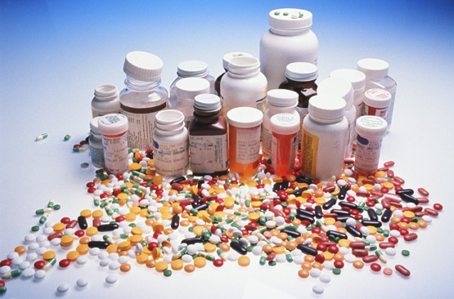
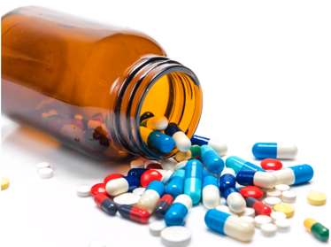
I have no disclosures or conflicts of interest
relevant to this presentation.

Slide 4
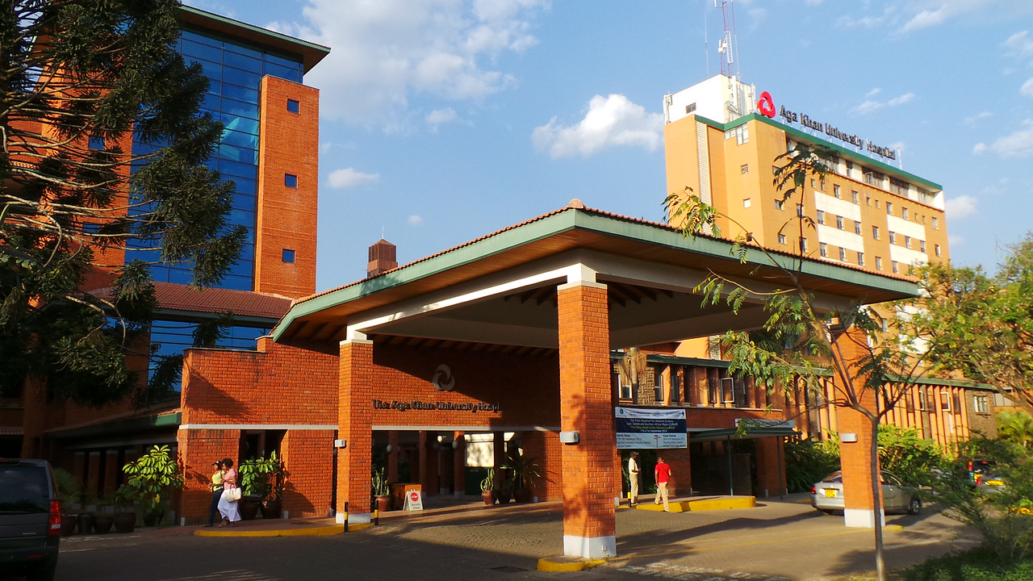


Slide 5


Slide 6
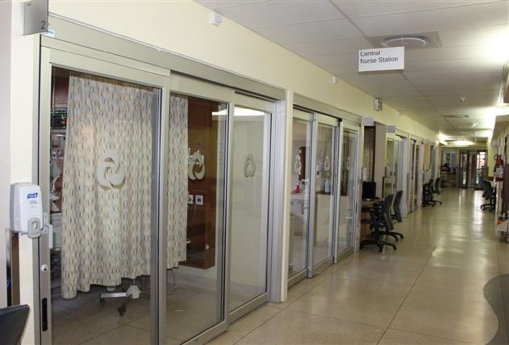

Slide 7

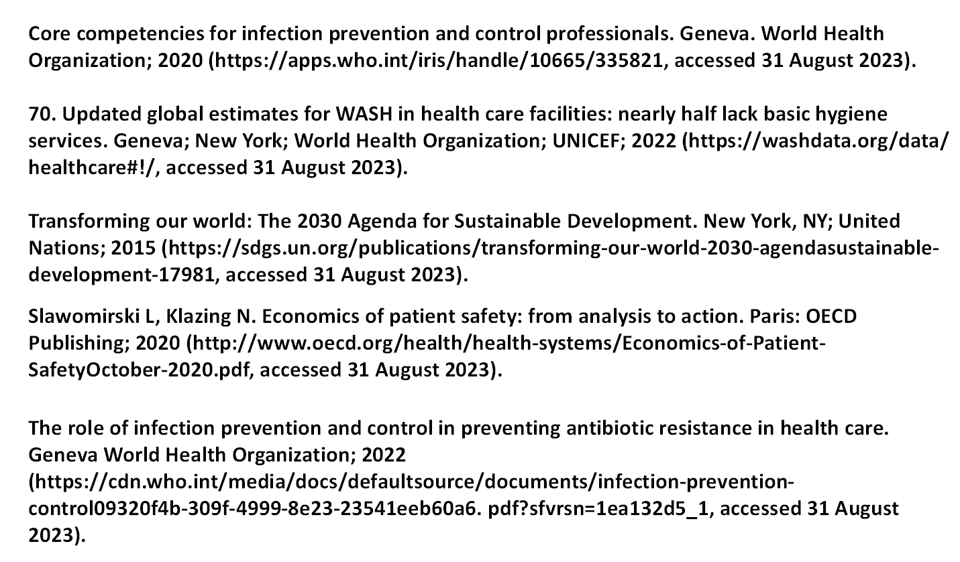

Slide 8
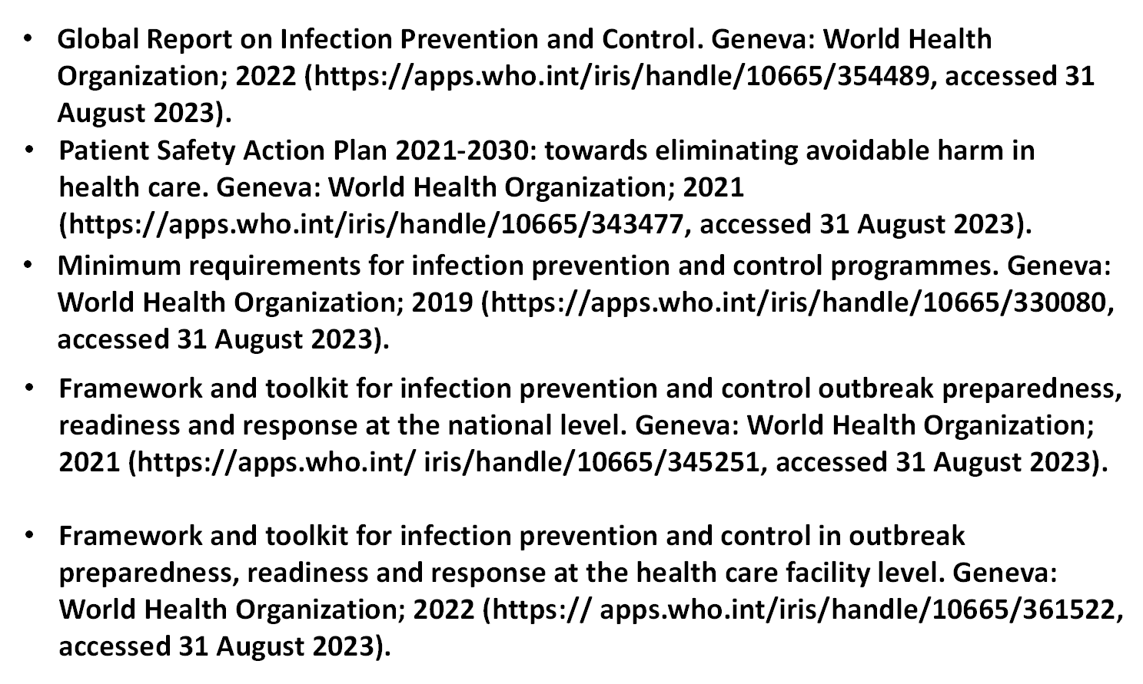

Slide 9

Open Education Sources for the PPT

Slide 10
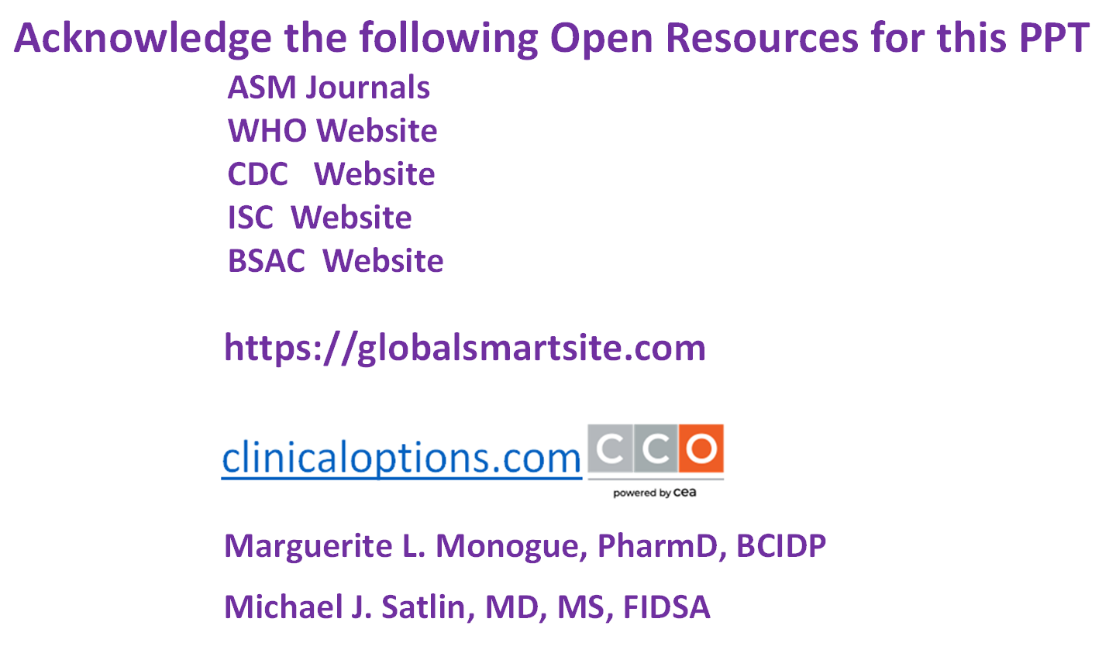

Slide 11


Slide 12
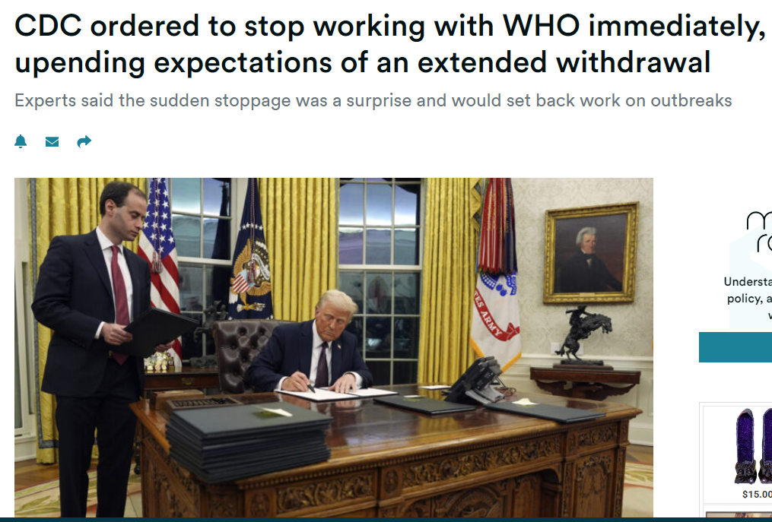

Slide 13
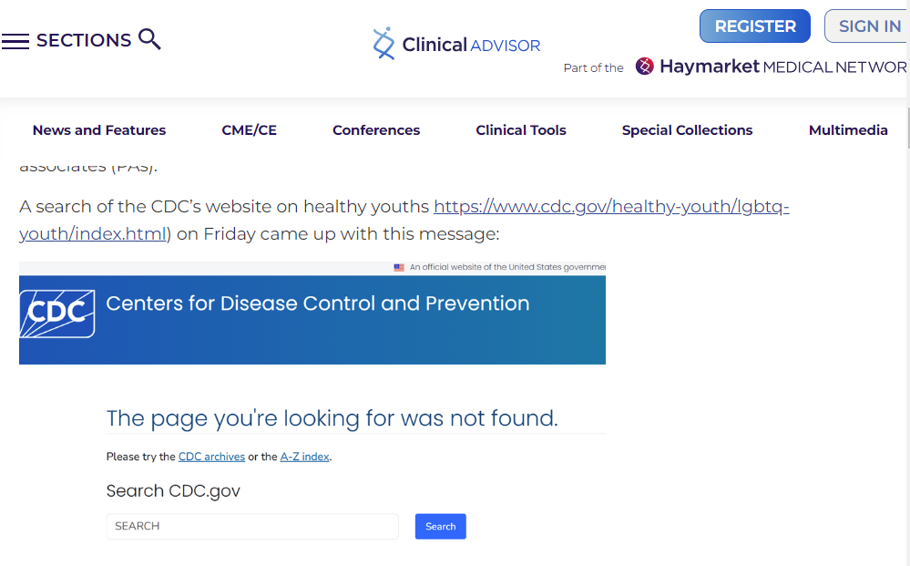

Slide 14
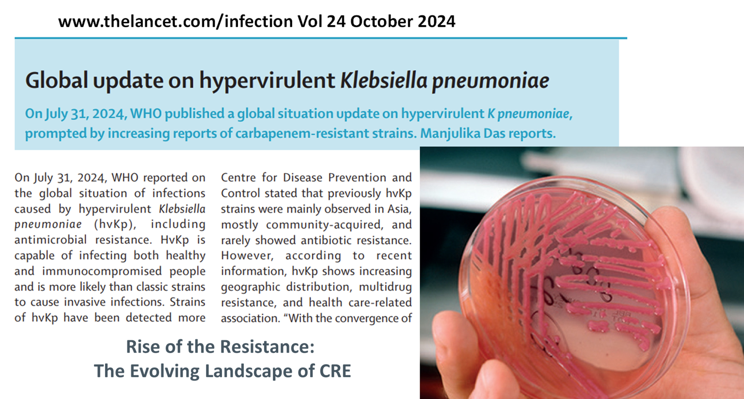

Slide 15
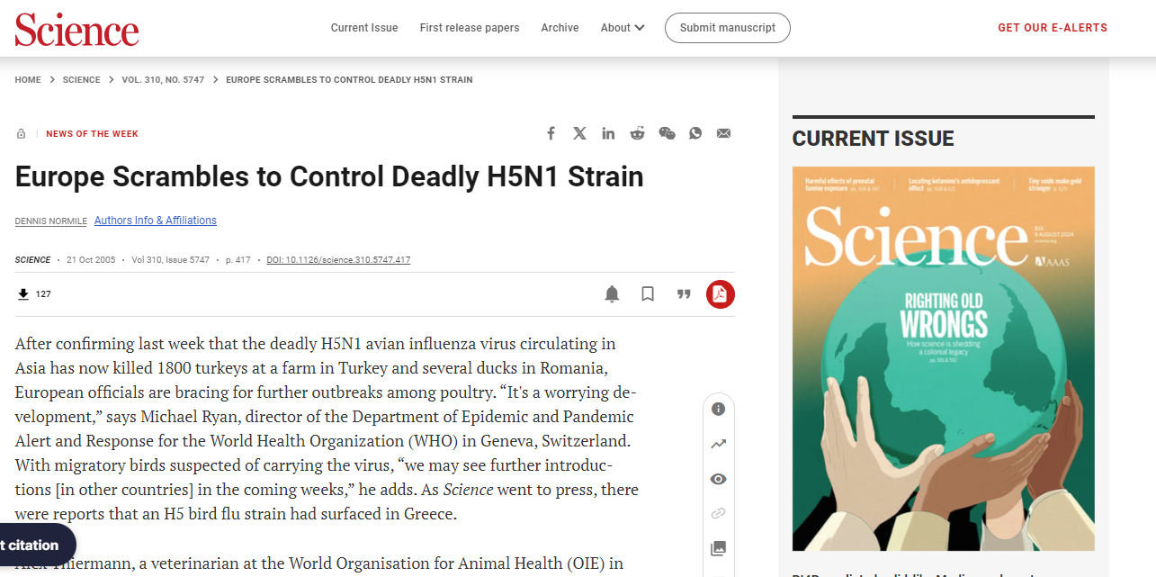

Slide 16
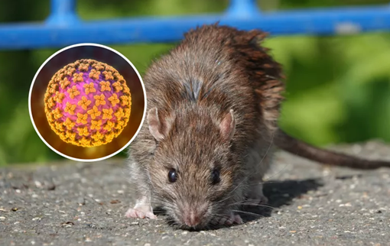

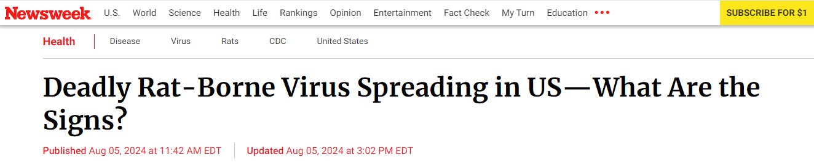
Health officials have issued a warning over the spread of a potentially fatal rat-borne virus in Arizona and other Southwestern states.
Hantavirus, caused three deaths in Arizona from January to July 2024, with seven confirmed cases across the state in total and two additional cases, one of which was fatal, in California.

Slide 17
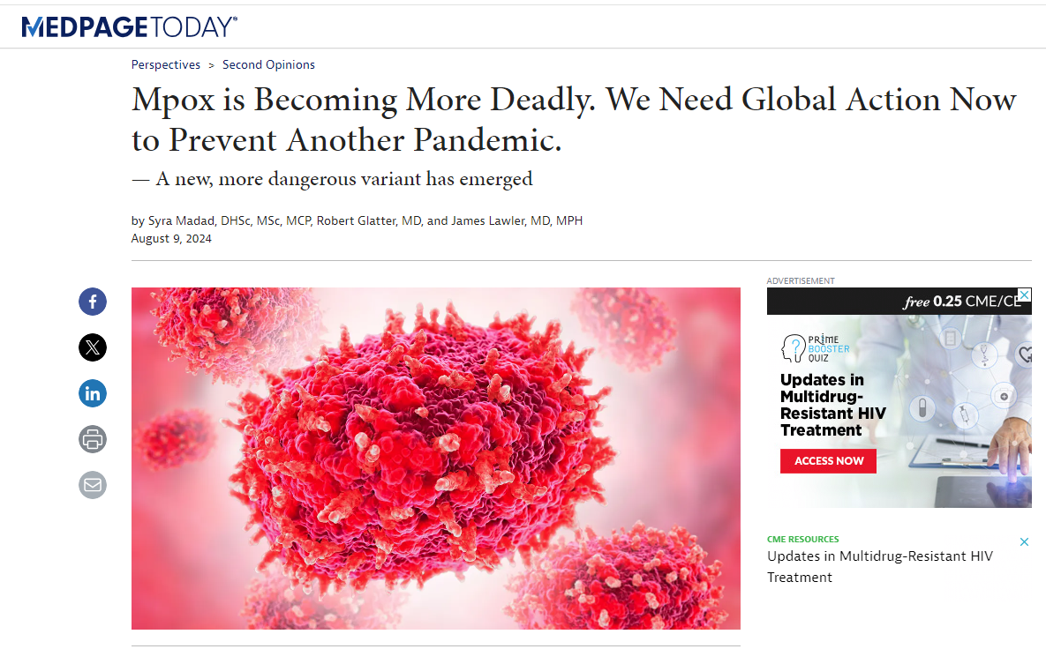

Slide 18
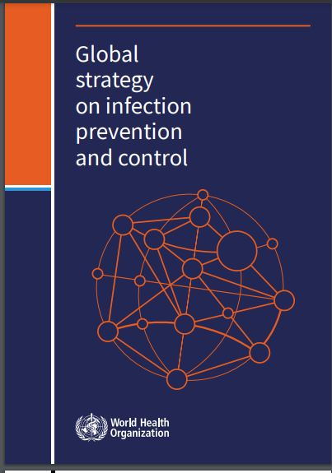


Slide 19
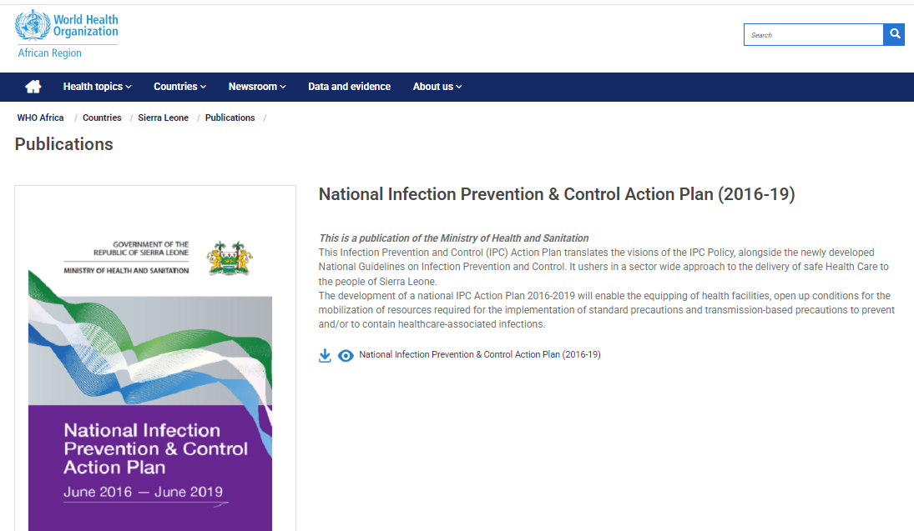

Slide 20
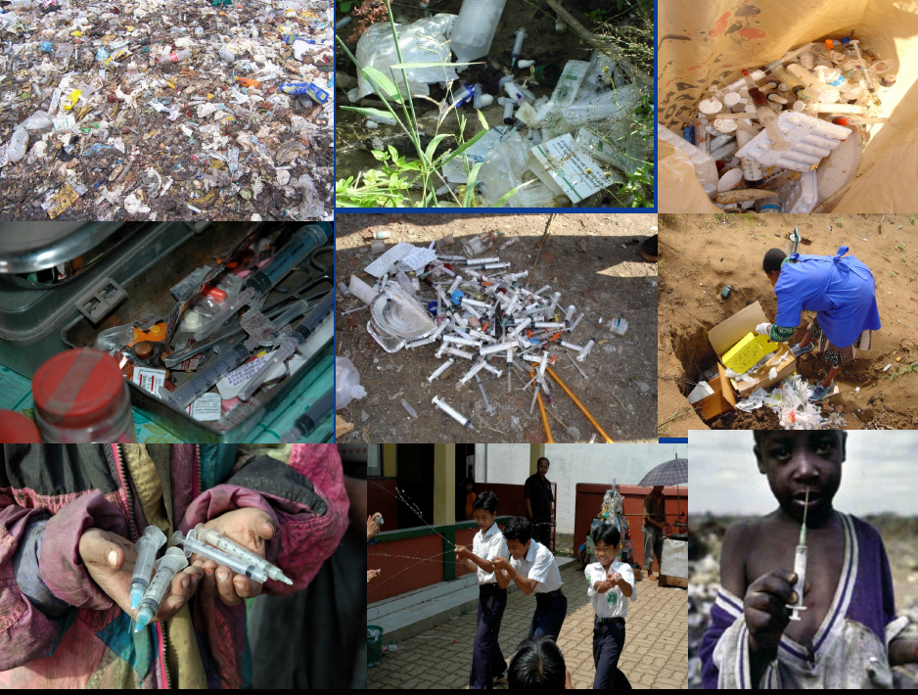

Slide 21
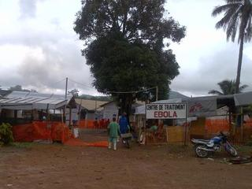
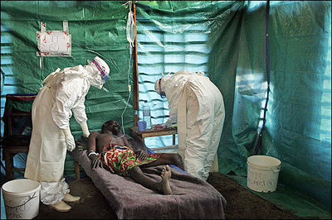

Slide 22

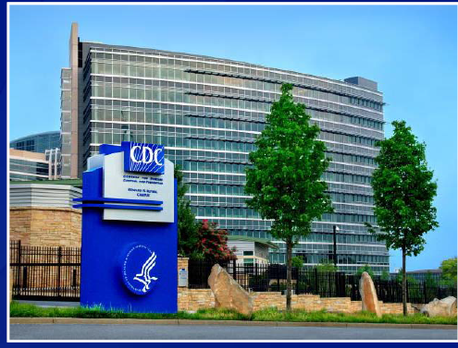

Slide 23
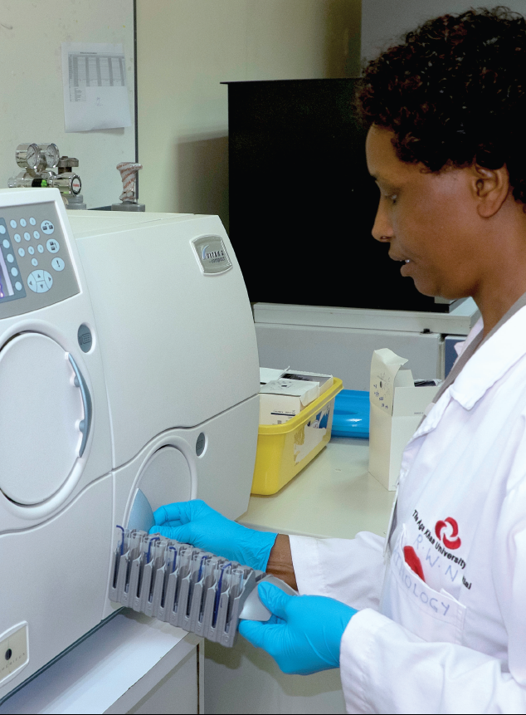
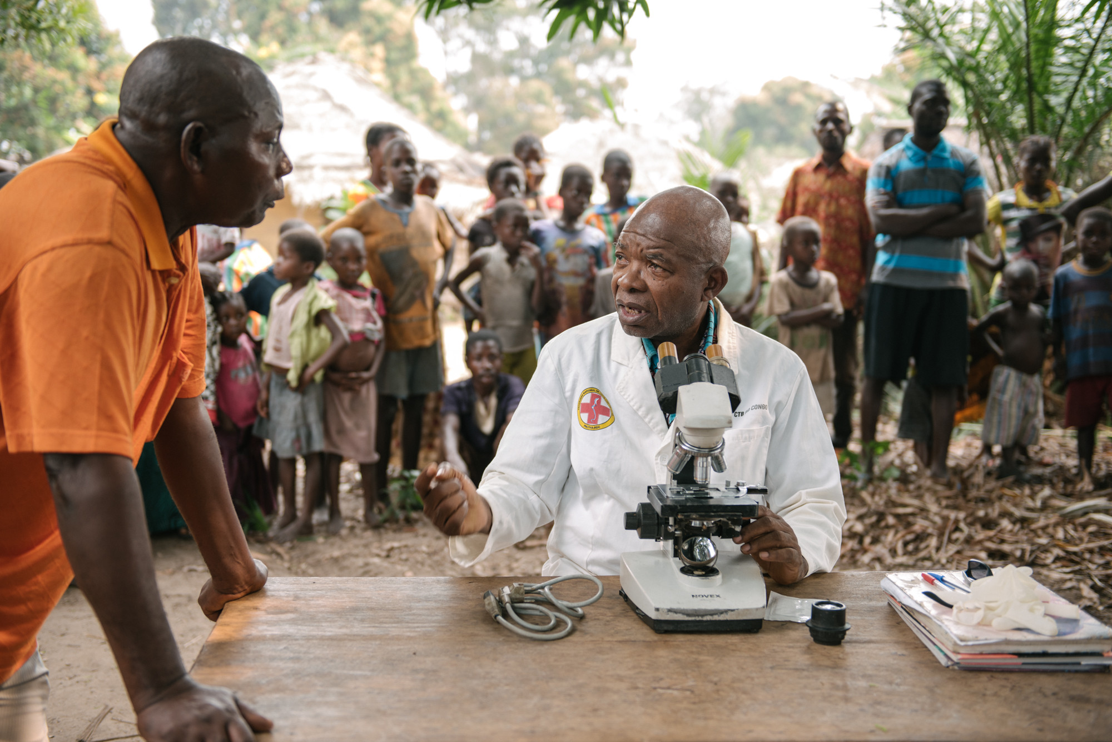
Disparities in Access to Diagnostics

Slide 24
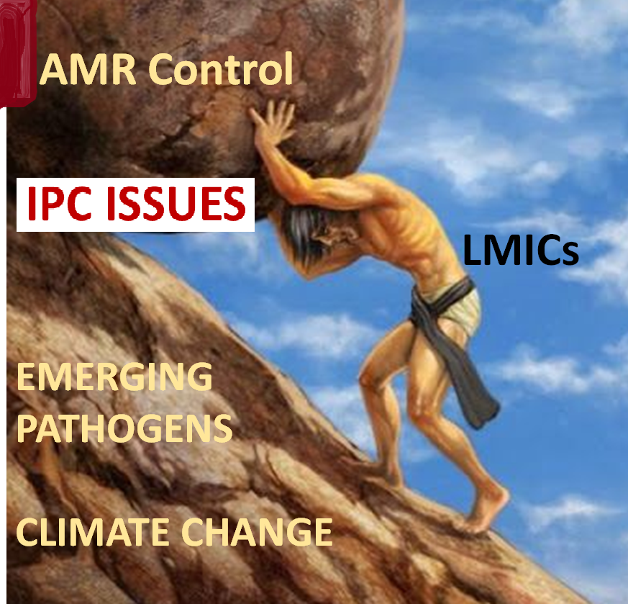

Slide 25
Patient in ICU

Slide 26
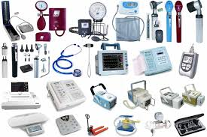
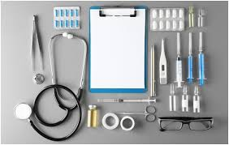
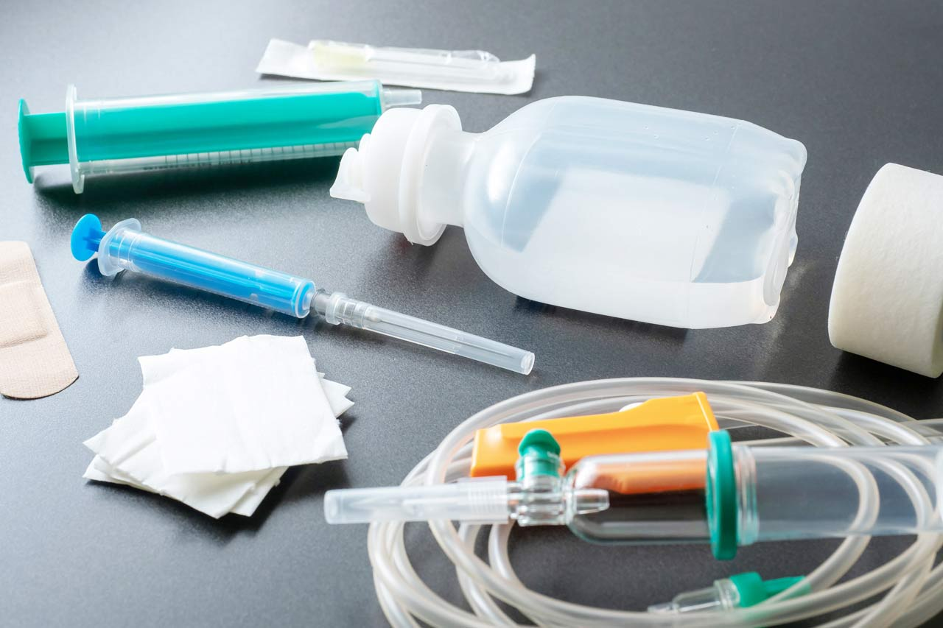
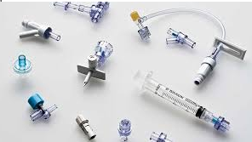

Slide 27
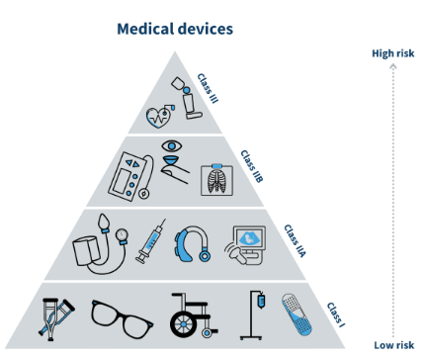

Slide 28
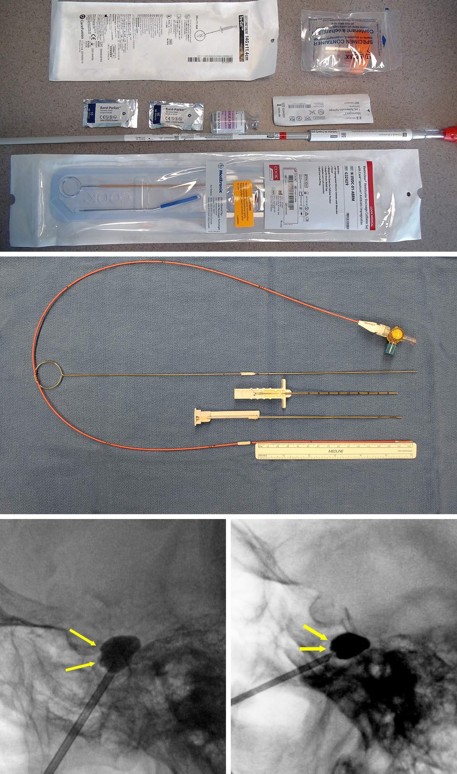

Slide 29
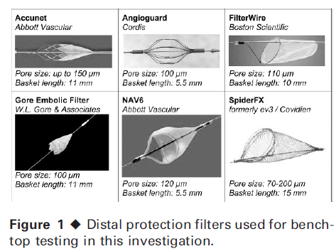

Slide 30
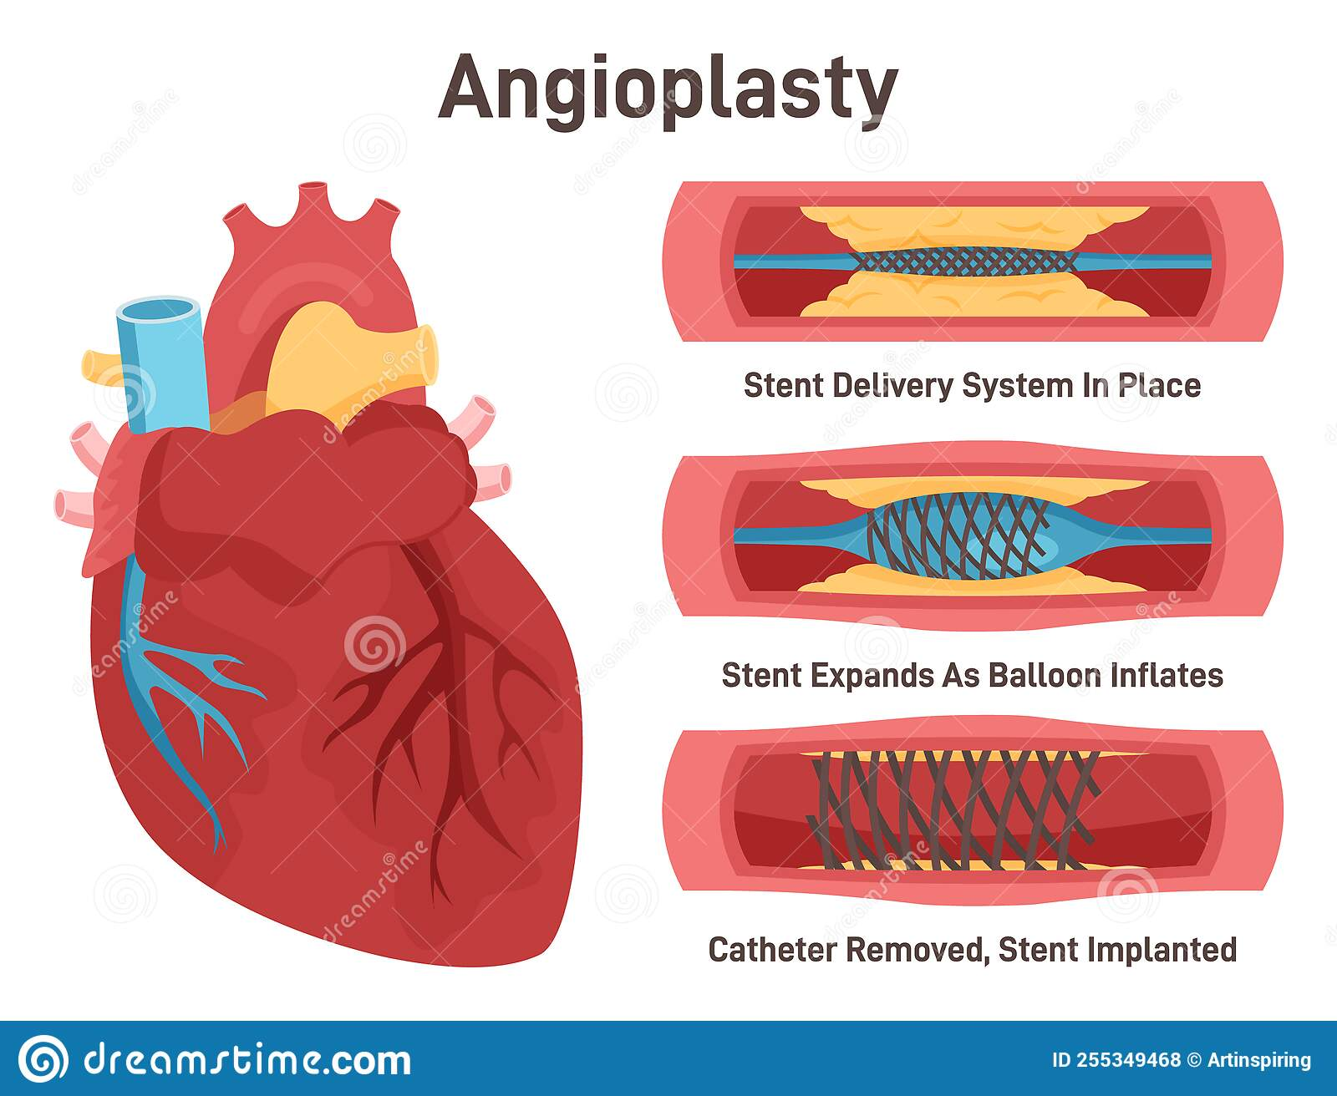

Slide 31
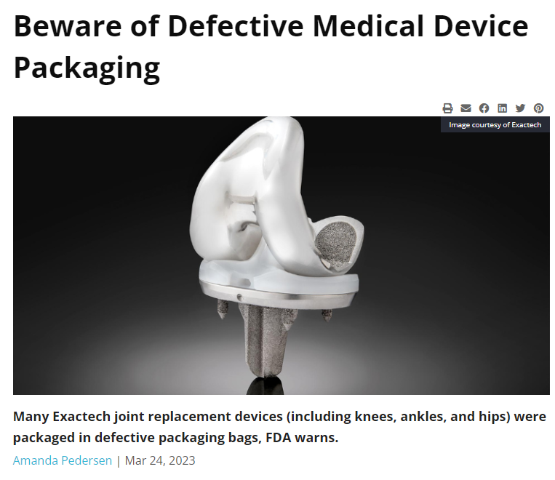

Slide 32
A Device can be Single Use OR
Reusable after Processing
Although many devices have been
labelled as ‘single-use’ by the original
manufacturers, a number of these are nonetheless reprocessed and reused

Slide 33
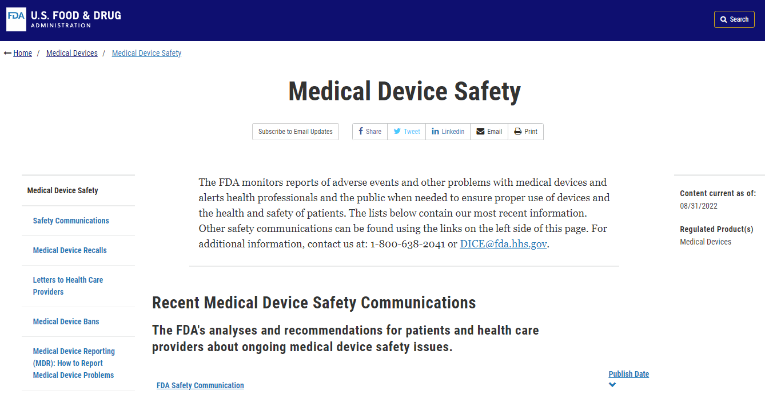

Slide 34
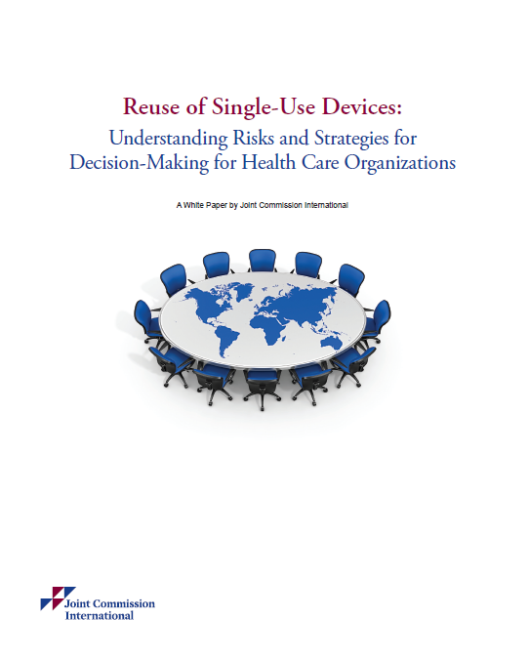

Slide 35
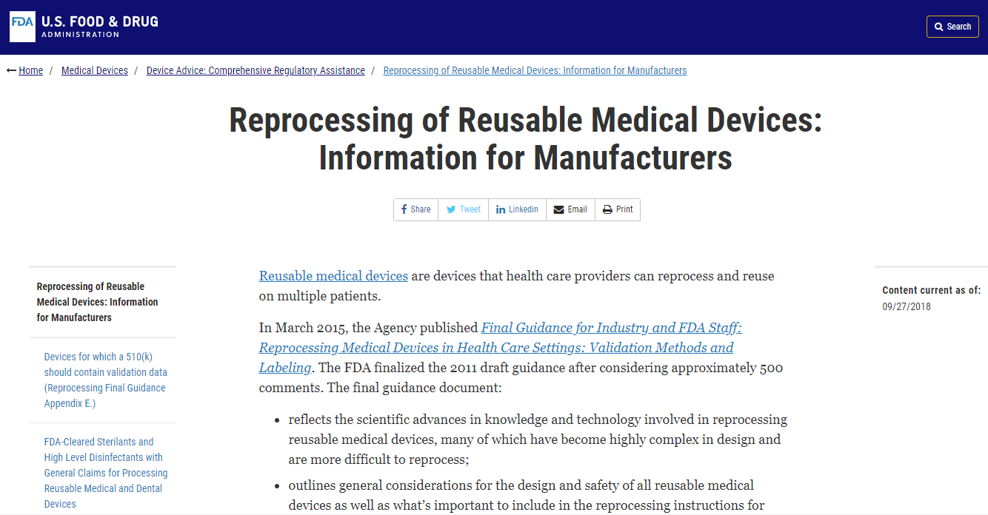

Slide 36
Reusable medical devices are devices that health care providers can reprocess and reuse on multiple patients.
Examples of reusable medical devices include surgical forceps, endoscopes and stethoscopes.

Slide 37
Reusable medical devices grouped into three categories according to the degree of risk of infection associated with the use of the device:
Critical devices, such as surgical forceps, come in contact with blood or normally sterile tissue.
Semi-critical devices, such as endoscopes, come in contact with mucus membranes.
Non-critical devices, such as stethoscopes, come in contact with unbroken skin.

Slide 38
These devices are designed and labelled for multiple uses
Are reprocessed by thorough cleaning followed by high-level disinfection or sterilization between patients.
Made of materials that can withstand repeated reprocessing, including manual brushing and the use of chemicals.

Slide 39
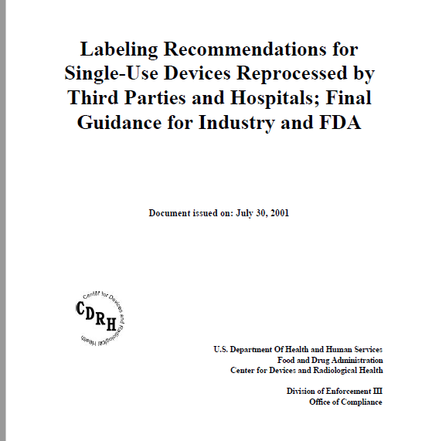

Slide 40
A "label" is a "display of written, printed, or graphic matter upon the immediate container of any device.“
Any information required on the immediate container of a device must also appear on the outside of container or wrapper, if any, of the retail package for the device, or be easily legible through the outside container or wrapper.
Section 201(k) of the Act; 21 CFR 1.3(b).

Slide 41
Examples of reusable medical devices are:
Surgical instruments, such as clamps and forceps
Endoscopes, such as bronchoscopes, duodenoscopes, and colonoscopes, used to visualize areas inside the body
Accessories to endoscopes, such as graspers and scissors
Laparoscopic surgery accessories, such as arthroscopic shavers

Slide 42
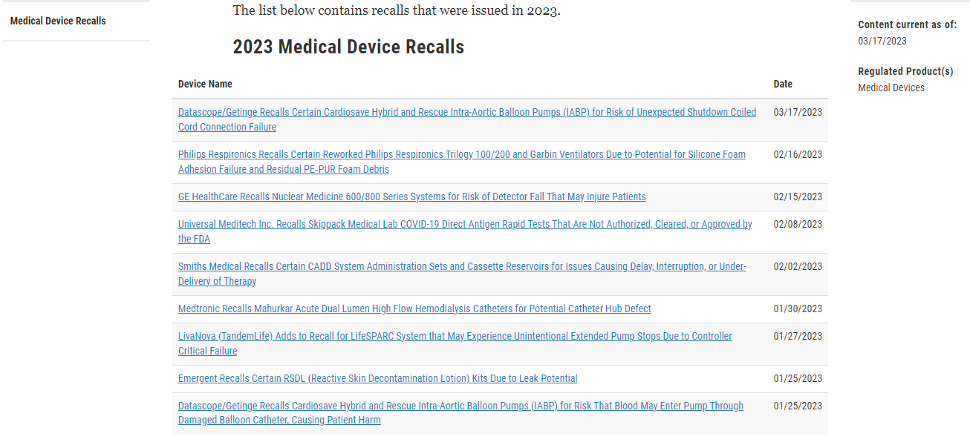

Slide 43
Single-use device
A single-use device, also referred to as a disposable device, intended for use on one patient during a single procedure
It is not intended to be reprocessed (cleaned, disinfected/sterilized) and used on another patient.

Slide 44
Reasons for single-use only
Design features. The device may be manufactured a certain way, making it impossible to properly sterilise, decontaminate and disinfect, which then could possibly be harmful if reused and cause cross-contamination.
Endotoxin reaction and chemical burns or sensitisation. ...
Patient safety

Slide 45
The trend of manufacturing single-use medical devices and supplies is paralleled by another trend—
attempting to clean and reuse these single-use medical devices and supplies for other patients
This practice carries significant risk to the patient

Slide 46
When a device is labelled as single use -
the manufacturer is claiming its safety for its use only once
The labelling may or may not identify the device as single-use or disposable and does not include instructions for reprocessing.
To reprocess such a device after it has been used, one must ensure that it is sufficiently clean or sterile and properly functioning, and will not pose a risk to the patient for whom it is used.

Slide 47
The risk of infection is the risk of disease transmission from reusing a disposable device.
This risk is greatest among “critical devices” that come into contact with blood or normally sterile tissue

Slide 48
It's important to be able to recognize which products are not made to be reused
Certain devices have not been tested to go into the autoclave or disinfectant, and putting them through the sterilization process compromises their size and shape and function

Slide 49
Certain disposable patient-care items have reusable heat-tolerant alternatives
Examples
High-volume Evacuator Tips,
Impression Trays,
Dental Burs,
Air And Water Syringe Tips

Slide 50
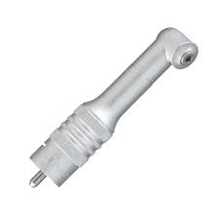
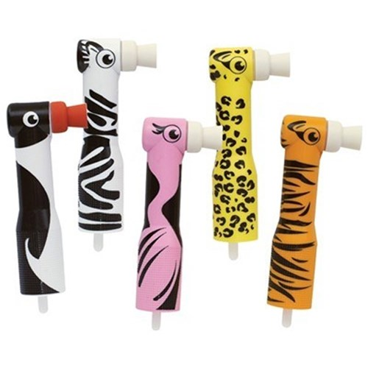
Prophylaxis angles in Dental clinics used to apply prophy paste to a patient's teeth during a routine hygiene appointment

Slide 51
Some devices―such as burs, endodontic files, and broaches- practical to consider them single-use because the way they are constructed makes them hard to clean.
Cleaning and heat sterilization can lead to deterioration on the cutting surfaces and raise the potential for breakage during patient treatment.
If such devices do not have reprocessing instructions, they should be considered single-use.

Slide 52
The medical devices used today are engineering marvels, with intricate materials, parts, and passageways
When a device is labelled as single use, the manufacturer is claiming its safety for use only once

Slide 53
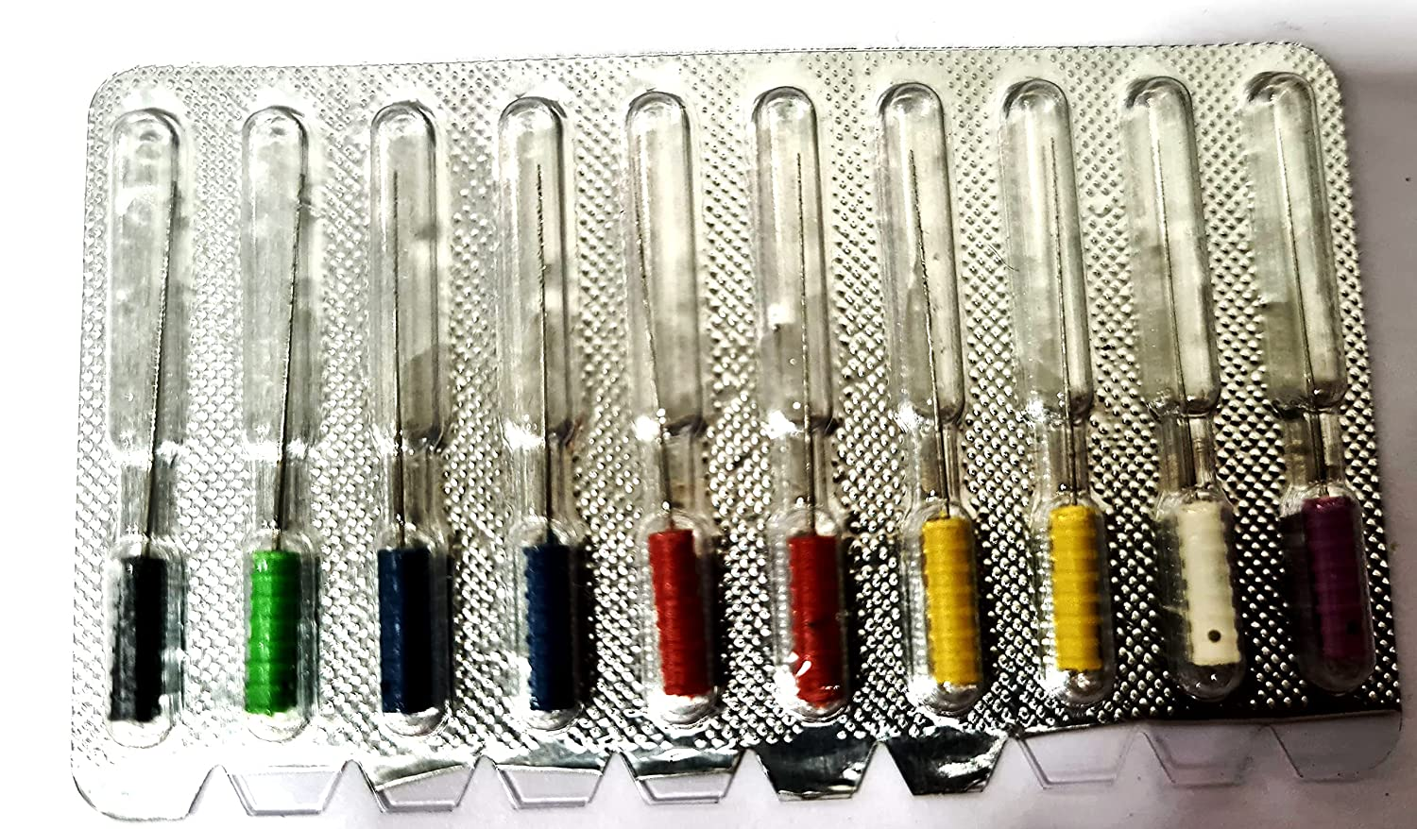
Dental API Root Canal Short Barbed Broaches files No30138 Ref Length 025 Size 0-6#

Slide 54
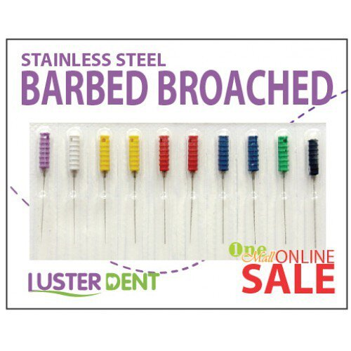
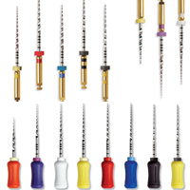
Endodontic Files and Broaches

Slide 55
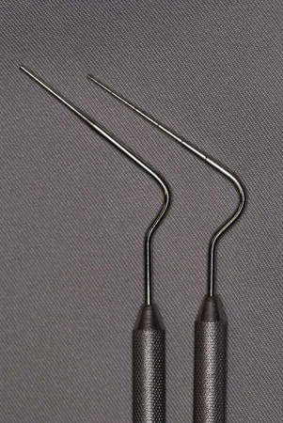
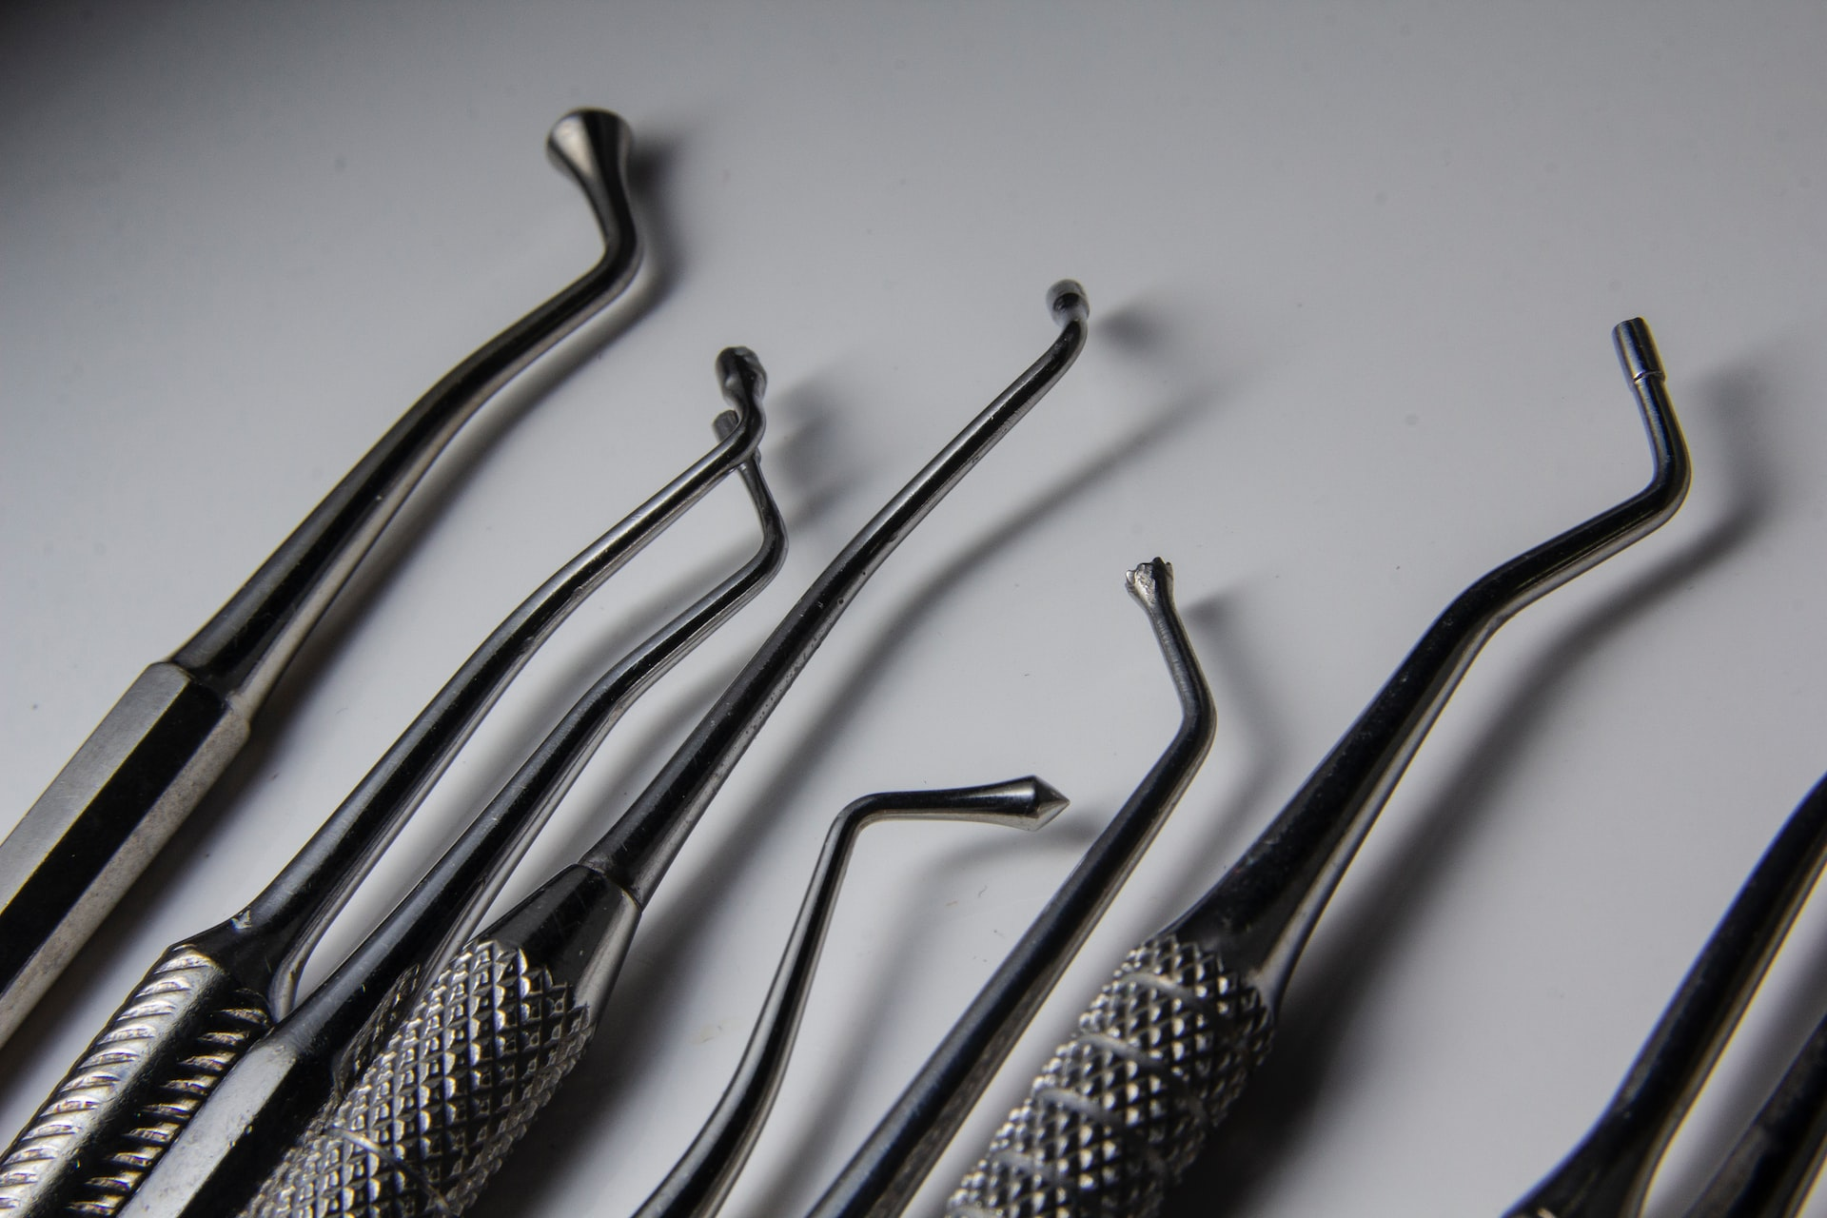

Slide 56
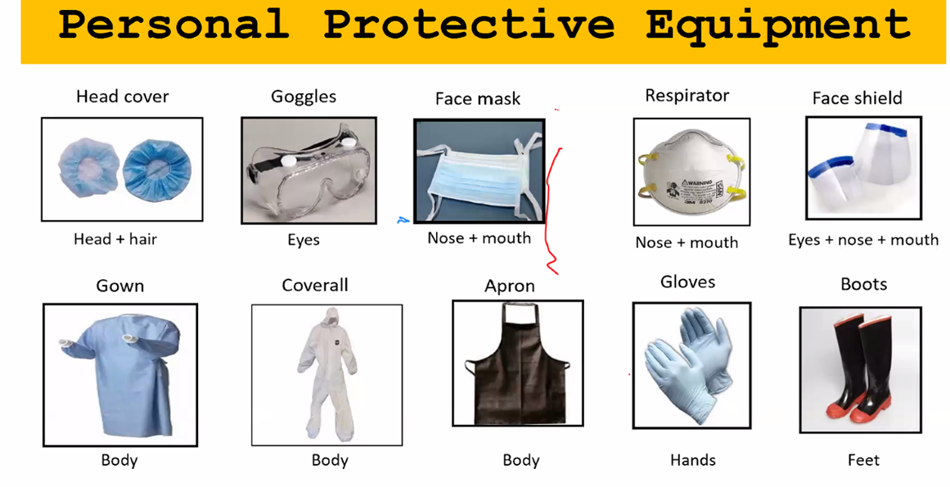

Slide 57
A suction tip cut open lengthwise to illustrate ample internal debris and staining (arrows, B), not visible on the outside of the device (A).
Note the characteristics in the design that make the instrument virtually
impossible to clean.

Slide 58
Some single-use items meet the definition of regulated medical waste and require special handling and disposal according to state, and local rules and regulations.
solid waste soaked or saturated with blood or saliva (e.g., gauze saturated with blood after surgery that would release blood when squeezed or compressed
gauze caked with dried blood that may be released during handling)
Contaminated sharp items such as needles and scalpel blades would be considered regulated waste

Slide 59
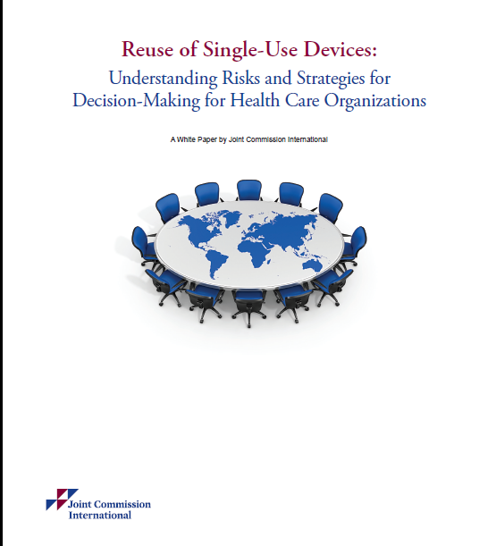
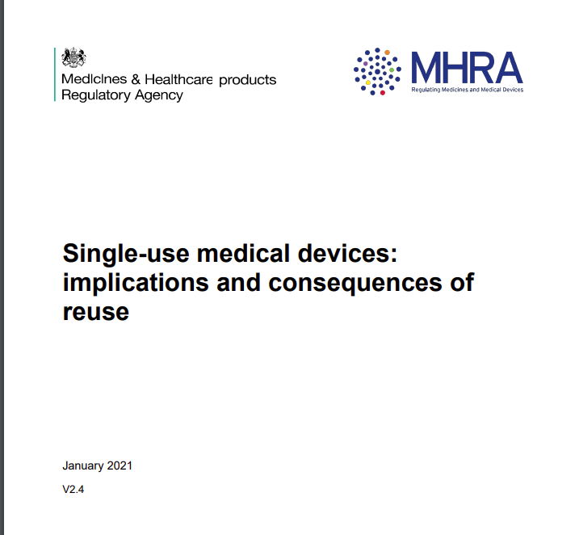

Slide 60
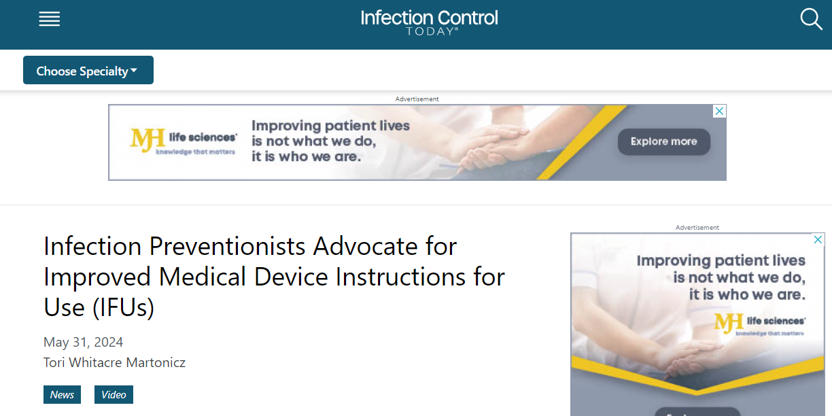
Notes:
60

Slide 61
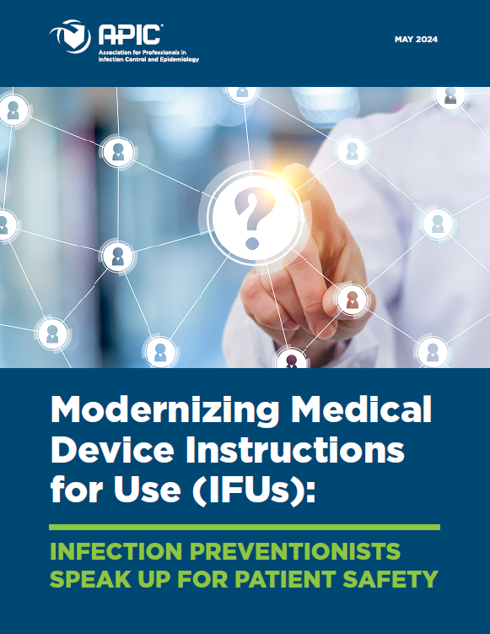

Slide 62



Slide 63


Slide 64

Patient in ICU

Slide 66
Single use devices also make it possible to create innovative designs, which in turn lead to faster, more efficacious, and less risky procedures.
Single use devices provide treatment that would not otherwise be available

Slide 67
What is reprocessing?
Reprocessing reusable medical devices typically consists of
Immediate Postoperative Pre-cleaning,
Complete cleaning,
Sterilization,
Repackaging,
Labelling and
Returning The Device To A Specified Condition and Performance

Slide 68
Can a single use device be cleaned, decontaminated and resterilised?
Does the refurbishment of single use devices affect their quality?
Does the refurbishment of single use devices affect their performance?
Does the refurbishment of single use devices affect their safety, i.e.
is it possible to cross-infect patients by using refurbished single use
devices?
4. Is it morally or ethically justified to treat a patient with a refurbished
single use medical device, which may be of lower quality,
performance or cleanliness than it was when used for the first time?

Slide 69
From Obstacles to Opportunities
Advancements in IPC Technology

Slide 70


Slide 71
Revolutionizing Infection Prevention:
AI-Driven UV Sanitization and Targeted Solutions
November 25, 2024By Tori Whitacre Martonicz
Autonomous UV sanitization system to improve hospital hygiene.
Traditional manual cleaning processes often need more consistency, leaving gaps in disinfection.
Shyld AI's system uses AI to identify high-risk surfaces and deploy a directional UV beam for precise sanitization, achieving pathogen reduction within seconds.

Slide 72
The compact, room-installed device seamlessly integrates into workflows, enhancing patient safety without disrupting operations.
Beyond infection control, AI applications in patient monitoring, fall detection, and optimizing hospital operations, ultimately improving health care quality globally while reducing HAIs effectively and affordably.

Slide 73

MULTI RESISTANT HEALTH CARE WORKER

Slide 74
These devices and supplies are often complex in design, and cleaning efforts, either by hospitals or third-party reprocesses, may be inadequate.
■Reprocessing and reuse may compromise the product’s performance
The manufacturer is not liable when a product is not being used according to the manufacturer’s instructions.

Slide 75
The trend to reprocess single-use devices was the result of health care organizations seeking cost savings by reprocessing instead of using a single-use device once and then discarding
Claims of environmental advantages
Reusing a single-use device is “greener,” resulting in less medical waste
Medical waste contributes to landfills and has considerable costs associated with proper disposal

Slide 76
Hospitals have been reprocessing SUDs in-house to start with.
Since the year 2000, a thriving third-party reprocessing industry emerged in North America and Europe
Only about 2%–3% of all devices can be safely reprocessed

Slide 77
Perhaps the strongest argument to support reusing single-use devices comes from developing countries and countries with limited resources, where the costs of health care can be prohibitively unaffordable to the typical patient

Slide 78


Slide 79


Slide 80
Reusing single use devices can substantially lower the cost of a single life saving procedure
and make it feasible for a segment of the population that might not otherwise be able to afford it

Slide 81
Often times countries with limited resources cannot depend on access to supplies and devices when they need them, and they may regard reuse of single-use devices as a way to ensure availability of necessary supplies

Slide 82
Consideration should be given as to whether the patient has the right to know
if a reprocessed single-use device will be used (and the opportunity to consent or object to its use).

Slide 83
Variation in country regulations
Once a country or region defines the regulations
for reuse of single-use medical devices, the legal requirements become clearer.
In the US, the FDA regulates which single-use devices can be reprocessed and has designated
70 such devices

Slide 84



